Slide 1
Contamination of food imports into the United States in the early days after the Fukushima accident
Robert L. Metzger, Ph.D.
Radiation Safety Engineering, Inc.

Slide 2
The Accident
Four Boiling Water Reactors involved.
Three were operating at full power.
Unit 4 was shut down for refueling and the fuel assemblies were outside of containment in the storage pool.
Units 5 and 6 were in cold shutdown.

Slide 3
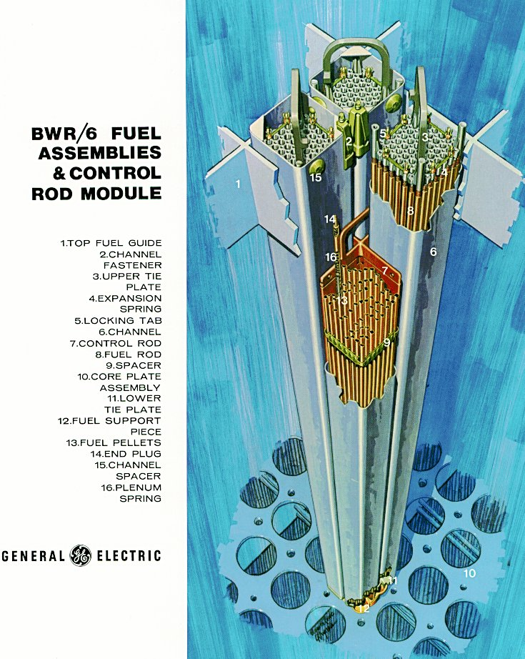
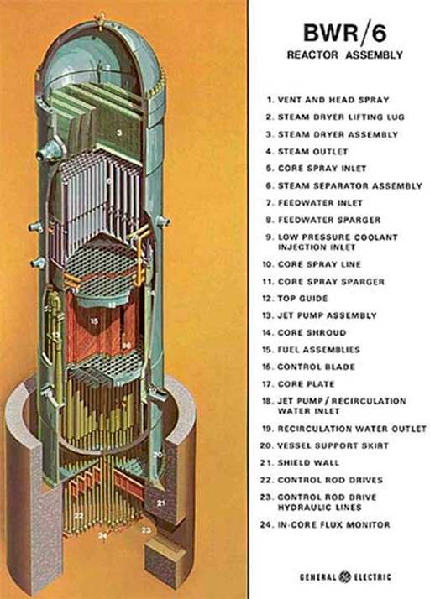
The Accident

Slide 4
The Accident
On March 11 at 2:46 PM a magnitude 9 earthquake struck under the ocean off the east coast of Japan.
Ground motion triggered a shutdown of all of the operating reactors (1- 3). Heat generation due to fission stopped.
At 3:42 PM a 14 meter tsunami hit the plant. It was designed to withstand a 6.5 meter wave. The tsunami flooded the site, filled the auxiliary buildings, terminated offsite power, and carried the fuel tanks for the emergency diesel generators out to sea. Station blackout.

Slide 5
The Accident
After shutdown, there is a significant amount of decay heat in the core that must be removed.
Several redundant systems are provided. All require power.
By 4:46 PM, the ECCS failed.

Slide 6
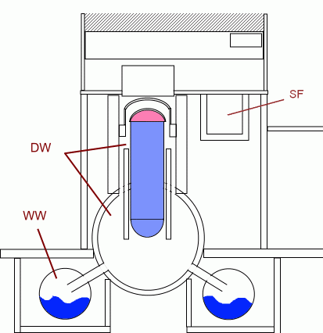
Hydrogen Generation
As temperature built, the core was exposed and cladding exceeded 1200 ° C. Zirconium burns in a steam atmosphere.
Zr + 2H₂0 ->ZrO₂ + 2H
It is an Exothermic reaction and increased heating further.
Once cladding ruptures fission products are released.
With no heat removal, the pressure and temperature built up, the core was exposed, and the cladding exceeded 1200 deg C.
Zr + 2H20 ->ZrO2 + 2H2
Exothermic reaction increased heat still further.
Once the cladding ruptured fission.

Slide 7
Containment
Containment sealed early in the accident.
Designed for 4 – 5 bar. Actual pressure built up to 8 bar.
Containment was depressurized for units 1 & 3 on March 12 – 13 and again later.
Released hydrogen gas burned in the service hall and destroyed the steel frame roof. A hydrogen gas explosion in Unit 2 containment was also observed.

Slide 8
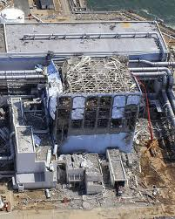
Unit 4
Unit 4 was shut down at the time of the earthquake and the core was in the spent fuel storage pool outside of containment.
A hydrogen explosion on March 15 led many to conclude that the core had become uncovered and melted.
It now appears that the hydrogen came through shared ductwork with Unit 3.
The Unit 4 core was not a major source or releases.

Slide 9
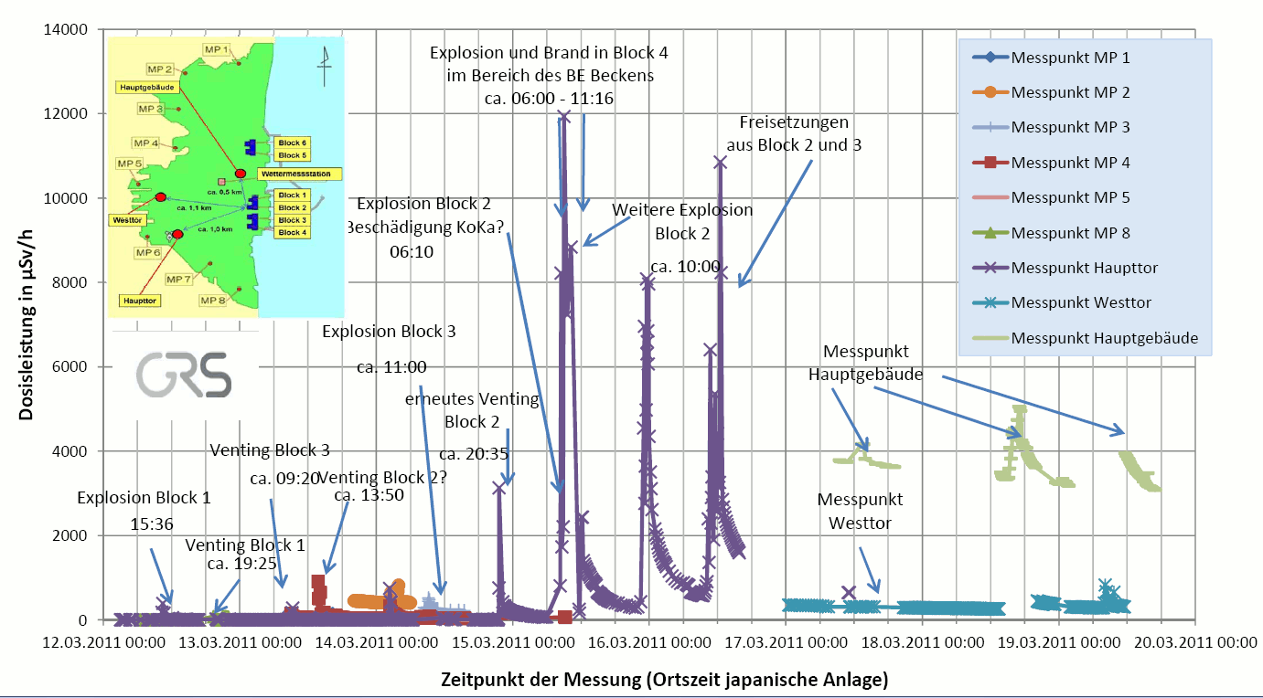
Early Releases

Slide 10
Airborne Releases
TEPCO estimates 500 PBq (13.5 MCi) of ¹³¹I, and 10 PBq (0.27 MCi) each of ¹³⁴Cs and ¹³⁷Cs were released to the atmosphere between March 12 to 31.
500 PBq of noble gases (primarily ¹³³Xe) were also released, although these played no role in food contamination.
20% came from Unit 1, 40% from Unit 2, and 40% from Unit 3.
Total releases are <20% of Chernobyl. Plume temperature was much colder than Chernobyl.

Slide 11
Ocean Releases
TEPCO estimates that 11 PBq (0.3 MCi)of ¹³¹I, 3.5 PBq of ¹³⁴Cs (95 KCi), and 3.6 PBq ¹³⁷Cs were released to the ocean from March 26 to September 30.
The containment breach in Unit 2 played an important role in these releases.
Japanese authorities quickly established a “no fishing” zone around the area that appears to have been effective.
Virtually all food contamination was due to the airborne releases.

Slide 12
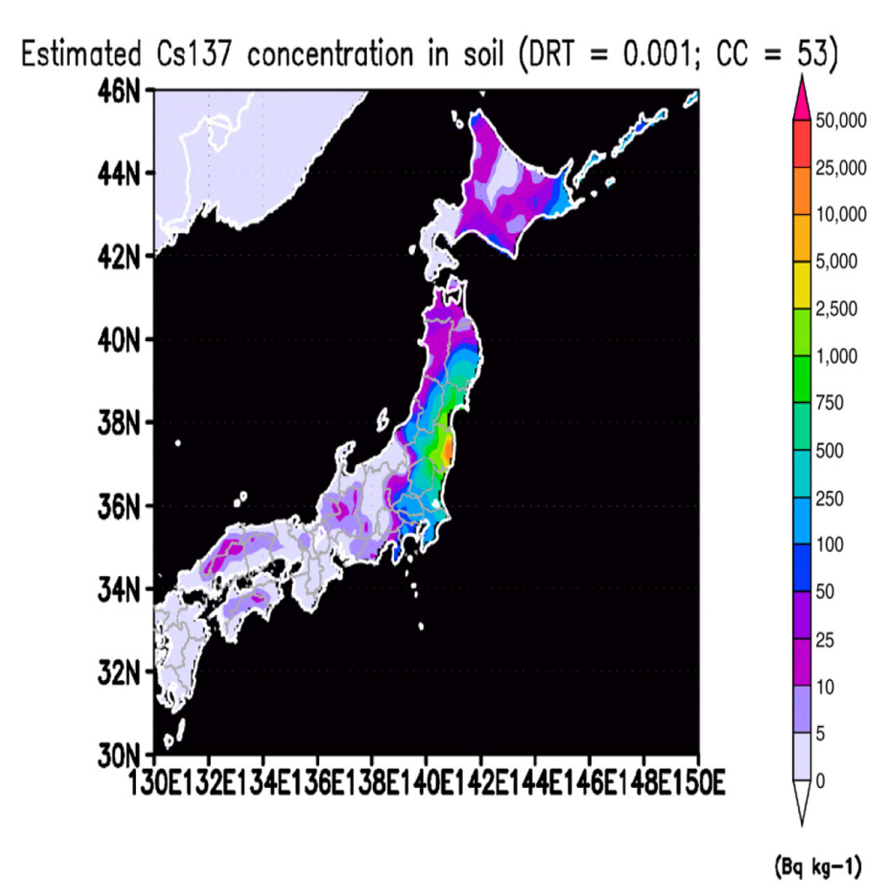
Ground Contamination
Airborne releases were relatively cold producing local wet and dry deposition from the plume.
Isotopes of Iodine and Cesium dominated the releases.
Japanese labs began monitoring food supplies immediately.

Slide 13
Water Contamination
Surface water was contaminated due to wet and dry deposition of fission products from the airborne releases, and from runoff.
Large quantities of seawater and fresh water were used to cool the damaged reactors. Since the fuel cladding was damaged in all four reactors, this water became highly contaminated with fission products. Much of this water escaped the site into the ocean after March 26.
Fishing restrictions were quickly established and proved to be effective.

Slide 14
Airborne Concentrations at the Lab

Slide 15
Wet Deposition at the Lab

Slide 16
Food Imports - Sushi
Japan is not a major exporter of food to the United States and much of this limited supply was disrupted by the earthquake and tsunami.
Sushi importers import fresh fish every two to three days.
Up to a dozen species of fish are imported in small numbers, and are quickly distributed to sushi restaurants.
Importers, concerned by the news coverage of the accident, began sending samples of imported seafood products in late March.

Slide 17
Seafood
The first observed food import that had observable contamination was found on March 30.
One species of seafood in a Sushi import was found to be contaminated with ¹³¹I only.
The source of the contamination was believed to be a food processing plant in Fukushima prefecture which had contaminated service water (unknown to them).
The food product was destroyed by the importer.

Slide 18
Koji Powder
On April 5, a shipment of Koji powder was found to be heavily contaminated with ⁶⁰Co, ¹²⁴Sb, ¹³¹I, ¹³²Te, ¹³⁴Cs and ¹³⁷Cs.
Koji powder is a precursor for Saki .
This, and subsequent samples, exceeded the FDA Derived Intervention Limit.
All were destroyed by the importer.

Slide 19
FDA DIL
Radionuclide Group | (Bq/kg) | (pCi/kg) | Milk (pCi/L)
Sr-90 | 160 | 4300 | 4400
I-131 | 170 | 4600 | 4700
Cs-134 + Cs-137 | 1200 | 32,000 | 33,000
Pu-238 + Pu-239 + Am-241 | 2 | 54 | 56
Ru-103 +Ru-106 | C₃/6800+C₆/450<1 | C₃/18,00+C₆/12,00<1 | C₃/190,000+C₆/12,000<1

Slide 20
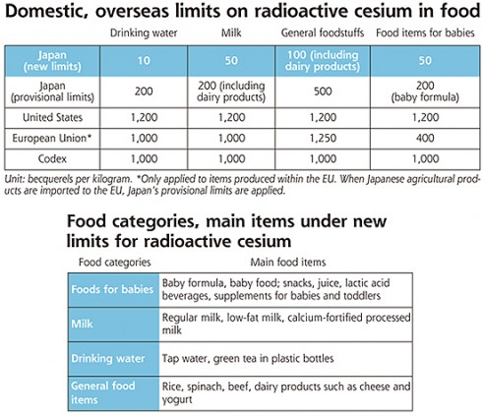
Japanese DIL

Slide 21
Green Tea
By July, the I-131 had largely decayed away and the primary concern was foods that were known concentrators of some of the isotopes.
The sample of the dried green tea leaves below has Cesium concentrations at 1/3 of the FDA DIL, but above the Japanese DIL at the time.
All contaminated product was not imported or destroyed.

Slide 22
Seaweed
By July, the impact of the water releases were observed in harvests of seaweed (a concentrator of Cesium isotopes) taken too close to the Daiichi plant.
Seaweed is used as a wrapper for Sushi.
The sample shown below is about 1/3 of the FDA DIL for Cesium, but above the Japanese DIL at the time.

Slide 23
Vegetables and Other Products
Our lab found no observable contamination in any other vegetable or other food product imported from Japan, to include those trapped under the FDA’s Import Alert 99-33.
Salmon, and other migratory fish species were similarly found to be free of contamination. None of the West coast commercial fisheries took fish anywhere near the East coast of Japan.
The Japanese restrictions on fishing in areas near the plant appear to be effective as does their monitoring of food products.

Slide 24
Comparison of Results
The FDA, performed extensive monitoring of food imports, both with portal monitors installed at the ports, and using their own radiochemistry laboratory.
Published results indicate they found little to no observable contamination of food products.
There are several possible explanations.
First is a matter of timing. We were testing samples while the accident was still in progress and therefore saw problems before the FDA started testing seriously.

Slide 25
Portal Monitors
Portal monitors found at the seaports can detect food contamination at and below the FDA DIL if:
The food is uniformly contaminated and is in close proximity to the portal.
The mass of the food is sufficient to alarm the portal. Portal monitors alarm based on the number of Bq in front of them, while the DIL is in units of Bq/Kg.
Many of the food items we found to be contaminated violated one or more of these criteria and therefore would not have been detected with a portal monitor.

Slide 26
Selection
If you think you have a problem with your finances, you would get help from:
A. The Internal Revenue Service
B. Your local accountant.
Importers used private labs to avoid problems with the FDA and other authorities. The samples submitted for testing were not random.
Consequently, the subset of samples seen at private labs may have been biased.

Slide 27
Conclusion
Imported food products contaminated with fission products from the Daiichi accident were detected starting in late March and April of 2011.
Conscientious importers tested their imported foods and destroyed any food that was found to be contaminated, even at levels well below the FDA DIL.
As a result, there was no observable impact on the imported foods to the US.

