Slide 1
The Case For Fractional Solubility Profiles
Robert L. Metzger
Radiation Safety Engineering, Inc.
Chandler, AZ
Keith F. Eckerman
Oak Ridge National Laboratory
Oak Ridge, TN

Slide 2
Lung Clearance
Inhaled dusts deposited in the extrathoracic region of the respiratory track are normally cleared by nose-blowing while other regions of the lung clear particles by a complex process of particle transport and absorption.
Absorption dominates the early lung clearance while the movement of particles towards the GI tract and lymph nodes dominates later phases.
Absorption and particle transport are competing processes, of which, only the absorption characteristics can be measured in vitro.

Slide 3
Solubility Classes
ICRP 68 defines three solubility types based on absorption clearance times:
All ICRP 68 based dosimetry codes (DCAL, IMBA) use these clearance types and correctly treat absorption and mechanical clearance mechanisms as competing processes.
Type F (fast) | 10 min (100%)
Type M (moderate) | 10 min (10%); 140 d (90%)
Type S (slow) | 10 min (0.1%) 7000 d (99.9%)

Slide 4
Assigned Values
The ICRP recommends that material-specific rates of absorption be used where reliable data exists, but assigns conservative estimates of one type to most compounds.
A review of the literature indicates that actual solubility profiles can be quite complex, with only radiopharamceuticals and tritium falling reliably into one absorption; Type F.
Other compounds are typically a mix of the different absorption types.

Slide 5
Routes of Intake & Excretion

Slide 6
ICRP Respiratory Tract Model

Slide 7
Absorption of Inhaled Activity

Slide 8
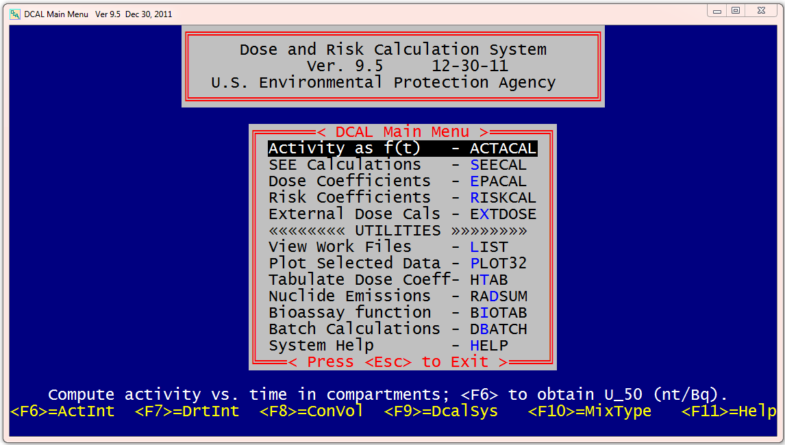
DCAL Software Main Menu

Slide 9
Solubility Profiles

Slide 10
Solubility Tests
Solubility tests are typically performed by placing a breathing zone air sample with the radionuclide compound of interest on it, in a beaker of serum lung ultrafiltrate, and them moving the filter to a new beaker each day for a week, and then weekly for a month. The activity in each beaker is determined, and the residual remaining on the filter is analyzed at the end of the test. The data is then plotted and fitted with a triple exponential.

Slide 11
Solubility Fitted Data

Slide 12
Solubility Plots

Slide 13
Bioassay
The solubility profile for a radionuclide compound is an important parameter for dose estimates generated from bioassay data. The lung model appears twice in the dose estimate, once to determine the activity inhaled (intake), and a second time to estimate the dose to the patient.
Errors in the lung model therefore compound.
The problem is particularly acute in dose estimates made only on early bioassay data as this is dominated by the fraction of Type F in the dust.

Slide 14
Conservative Estimates
The default values for solubility are single absorption type and are generally “conservative”.
The default values, though, may over or under estimate dose and risk when used with bioassay data.
Uranium, for example, is nephrotoxic in its soluble forms (e.g. UO₂), but radiotoxic in its more insoluble forms (high fired U₃O₈). Errors in the solubility profile will necessarily overestimate one risk and underestimate the other.

Slide 15
Accident Dose Assessment
Dose estimates must be made quickly after an incident where personnel have potentially inhaled significant quantities of radionuclides. The window of time where treatment can be effective is frequently short. This necessitates that dose estimates and treatment decisions be made on a solitary bioassay measurement at ~4 to 24 hours after the incident.
Physicians do not want “conservative” (read biased) dose estimates as they must decide whether to employ a treatment that itself entails some risk.

Slide 16
Dose Assessment
To assess the errors associated with the default solitary solubility classes, a series of analyses were run using the default solubility class and the actual solubility data, where the dose estimate was based on a single urine bioassay measurement.
The intake and dose were estimated using DCAL Version 9.5 assuming an acute airborne exposure with an AMAD of 5 microns 24 hours prior to the bioassay.
Both the intake from the bioassay measurement and the projected dose were calculated.

Slide 17
Test Compounds

Slide 18
Results
Product | Intake (Bq) Default Profile | Intake (Bq) Actual Profile | Intake Ratio Default:Actual
Uranium Metal - Recycling Smelting | 8.70E+06 | 3.17E+06 | 2.74
DU Munitions | 8.70E+06 | 4.17E+05 | 20.9
DU Munitions after Heat Treatment | 8.70E+06 | 1.64E+06 | 5.30
UO₂ from In Situ Mine | 8.70E+06 | 1.25E+07 | 69.6
PuO₂ (1750̊ C) | 6.76E+08 | 1.50E+07 | 44.9
AmO₂ (1750̊ C) | 1.63E+08 | 5.41E+06 | 30.1
U₃O₈ (High Fired - Exxon) | 8.70E+06 | 3.77E+05 | 23.0

Slide 19
Results
Product | Dose (Sv) Default Profile | Dose (Sv) Actual Profile | Dose Ratio Default:Actual
Uranium Metal - Recycling Smelting | 49.8 | 17.9 | 1.79
DU Munitions | 49.8 | 1.9 | 26.3
DU Munitions after Heat Treatment | 49.8 | 8.97 | 5.56
UO₂ from In Situ Mine | 49.8 | 0.105 | 472
PuO₂ (1750̊ C) | 5700. | 220 | 26.0
AmO₂ (1750̊ C) | 1400 | 93.8 | 16.7
U₃O₈ (High Fired - Exxon) | 49.8 | 1.67 | 29.9

Slide 20
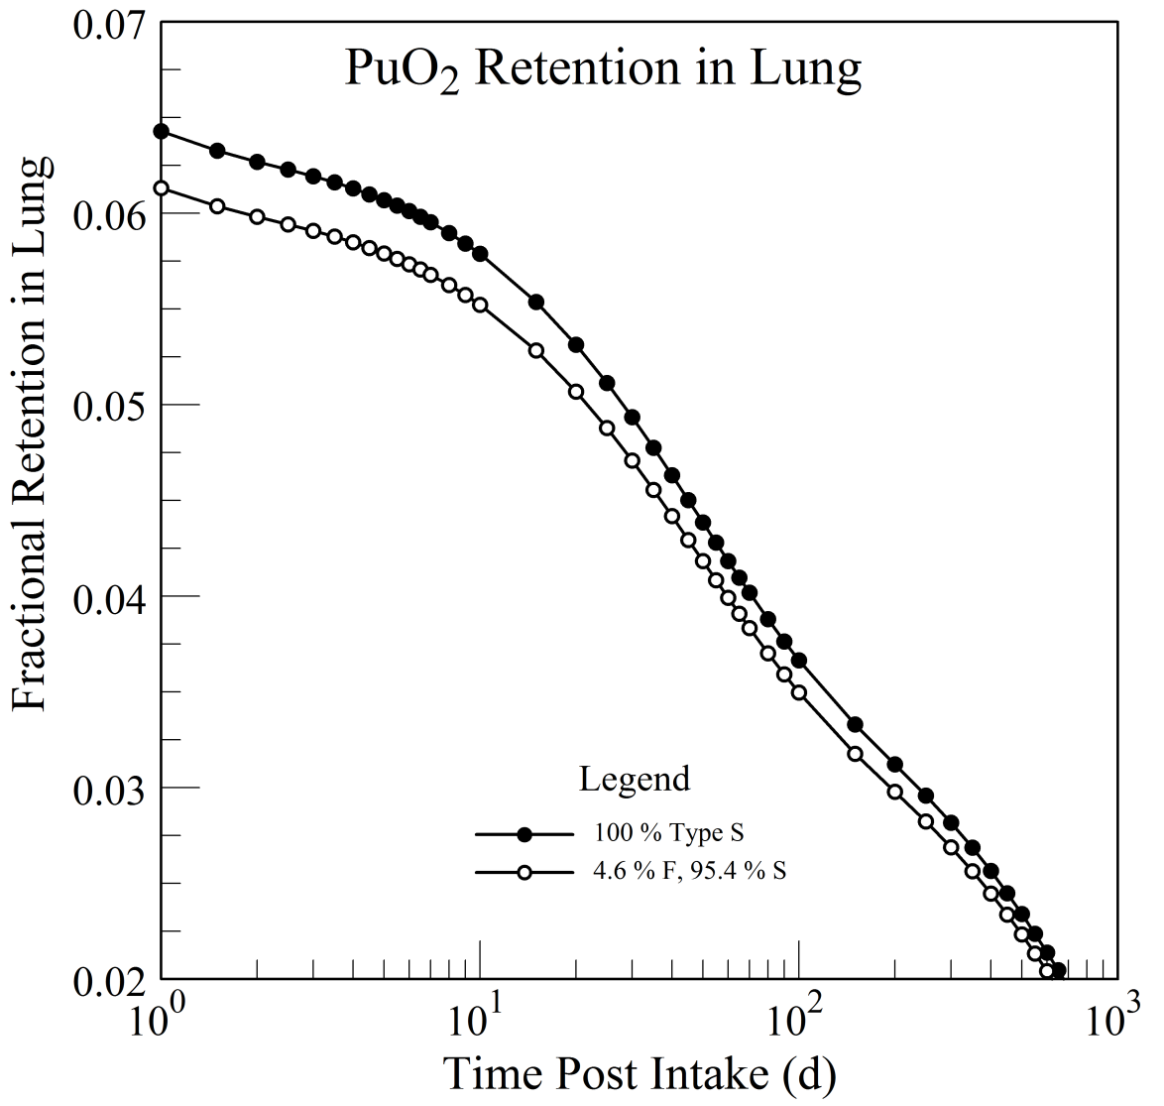
PuO₂ in the Lung

Slide 21
PuO₂ in Urine

Slide 22
Summary
The dosimetry test indicates the use of default solubility profiles with only one absorption type introduces order-of-magnitude errors into the dosimetry estimates for many common radionuclide compounds when the dosimetry estimate is made based urine bioassay data taken shortly after the incident.
Since the urinary excretion in the early times after an incident is almost entirely on the fraction of the compound that falls into the Type F, every effort should be made to estimate this value.

Slide 23
Dosimetry Codes
Internal dosimetry codes should be modified to allow fractional absorption types to be entered, and the fractional values should be used in all cases where any data is available.
With the exception of radiopharmaceuticals and tritium, an estimate of the Type F fraction should always be made.
DCAL software has been modified to accept the fractional solubility profiles.

